Slide 1
Machine Learning
Lesson 5: Supervised Learning–Classification

Slide 2

Classification: A supervised learning algorithm
Decision Tree
Random Forest
Naïve Bayes
Confusion Matrix vs Cost Matrix
Kernel SVM

Slide 3
By the end of this lesson, you will be able to:
Understand classification as part of supervised learning
Demonstrate different classification techniques in Python
Evaluate classification models

Slide 4
Classification
Topic 1: Definition of Classification
Notes:
Trainer Notes: Explain the following:
1 What is classification with respect to machine learning

Slide 5
What Is Classification?
A machine learning task that identifies the class to which an instance belongs
Acme Article
Acme Article
Acme Article
Technology
Acme Article
Food Article
Food Article
Food Article
Sports
Bar Article
Bar Article
Bar Article
Entertainment
Notes:
Trainer Notes: Explain the following:
1. The above example with respect to classsification

Slide 6
Classification: Example
Training a classifier model with respect to the available data
Classification
Algorithms
Training
Data
Name | Rank | Years | Tenured
Mike | Assistant Prof | 3 | no
Mary | Assistant Prof | 7 | yes
Bill | Professor | 2 | yes
Jim | Associate Prof | 7 | yes
Dave | Associate Prof | 6 | no
Anne | Associate Prof | 3 | no
Classifier
(Model)
IF rank = “professor”
OR years > 6
THEN tenured = “yes”
Notes:
Trainer Notes: Explain the following:
1. Classification high level process with respect to the above example.

Slide 7
Classification: Example
The model will classify if the professors are tenured or not
Classifier
Testing
Data
Unseen Data
(Jeff, Professor, 4)
Name | Rank | Years | Tenured
Tom | Assistant Prof | 2 | no
Merlisa | Assistant Prof | 7 | no
George | Professor | 5 | yes
Joseph | Assistant Prof | 7 | yes
Tenured?
Yes
Notes:
Trainer Notes: Explain the following:
1. Classification model working on unseen data

Slide 8
Classification: Work Flow
A typical classifier model workflow with input training data and output labels
(a) Training
label
machine
learning
algorithm
feature
extractor
input
features
(a) Prediction
feature
extractor
Classifier
model
label
features
input
Notes:
Trainer Notes: Explain the following:
1. Classification workflow from data acquisition to label prediction

Slide 9
Classification: A Supervised Learning Algorithm
Classification is a supervised learning algorithm as the training data contains labels
Supervised Learning Model
Record ID | Age | Spectacle Prescription | Astigmatic | Tear production Rate | Class Label Lenses
1 | Young | Myope | No | Reduced | Noncontact
2 | Young | Myope | No | Normal | Soft contact
3 | Young | Myope | Yes | Reduced | Noncontact
4 | Young | Myope | Yes | Normal | Hard contact
5 | Young | Hypermetrope | No | Reduced | Noncontact
6 | Young | Hypermetrope | No | Normal | Soft contact
7 | Young | Hypermetrope | Yes | Reduced | Noncontact
8 | Young | Hypermetrope | Yes | Normal | Hard contact
9 | Pre-presbyopic | Myope | No | Reduced | Noncontact
10 | Pre-presbyopic | Myope | No | Normal | Soft contact
11 | Pre-presbyopic | Myope | Yes | Reduced | Noncontact
12 | Pre-presbyopic | Myope | Yes | Normal | Hard contact
13 | Pre-presbyopic | Hypermetrope | No | Reduced | Noncontact
14 | Pre-presbyopic | Hypermetrope | No | Normal | Soft contact
15 | Pre-presbyopic | Hypermetrope | Yes | Reduced | Noncontact
16 | Pre-presbyopic | Hypermetrope | Yes | Normal | Noncontact
17 | Presbyopic | Myope | No | Reduced | Noncontact
18 | Presbyopic | Myope | No | Normal | Noncontact
19 | Presbyopic | Myope | Yes | Reduced | Noncontact
20 | Presbyopic | Myope | Yes | Normal | Hard contact
Feature
Vectors
Training Text,
Documents,
Images, etc.
Labels
Machine
Learning
Algorithm
Feature
Vectors
New Text,
Document,
Images, etc.
Predictive
Model
Expected
Label
Notes:
Trainer Notes: Explain the following:
Map the above dataset to the adjacent classification model
How the model will work with the dataset to predict labels (noncontact/softcontact/hard contact)

Slide 10
Classification
Topic 2: Use Cases and Algorithms

Slide 11








Sentiment Analysis
Notes:
Trainer Notes: Explain the following:
1. How sentiment analysis is a classification algorithm

Slide 12




Fraud Detection
Notes:
Trainer Notes: Explain the following:
1. How fraud detection is a classification algorithm

Slide 13





Face Detection
Notes:
Trainer Notes: Explain the following:
1. How face detection is a classification algorithm

Slide 14
Classification Algorithms
Few of the most commonly used classification algorithms:
Decision Tree
Support Vector Machines (SVM)
Random Forest
Naîve Bayes Classifier
Notes:
Trainer Notes: Explain the following:
1. There are 4 majorly used classification algorithms

Slide 15
Classification
Topic 3: Decision Tree Classifier
Notes:
Trainer Notes: Explain the following:
1. A tree based classification algorithm

Slide 16
Decision Tree Classifier
ROOT Node
Branch/Sub-Tree
Splitting
Decision Node
A
Decision Node
B
C
Terminal Node
Decision Node
Terminal Node
Terminal Node
A tree-like structure in which the internal node represents the test on an attribute
Terminal Node
Terminal Node
Each branch represents the outcome of the test, and each leaf node represents the class label
A path from root to leaf represents classification rules
Notes:
Trainer Notes: Explain the following:
Root node, decision node, terminal node
The split
Tree based classification approach

Slide 17
Decision Tree: Schematic Representation
The tree is splitted whenever an impure node is detected
a1 a2 a3 a4 a5 a6
X
Y
Z
If impure node is detected,
select best attribute
and continue
If impure node is detected,
select best attribute
and continue
If pure node is detected, it can be classified as leaf node
Notes:
Trainer Notes: Explain the following:
Explain pure node and impure node
Why to split an impure node

Slide 18
Decision Tree: Example 1
Below example illustrates the splitting attributes with respect to the adjacent training data
categorical
categorical
continuous
class
Splitting Attributes
Refund
Yes
No
NO
MarSt
Single, Divorced
Married
TaxInc
NO
< 80K
> 80K
NO
YES
Training Data
Notes:
Trainer Notes: Explain the following:
1. Explain the formation of the above decision tree with respect to the adjacent data

Slide 19




Decision Tree: Example 2
Forming a decision tree to check if the match will be played or not based on climatic conditions
Play = 3
Don’t play = 0
Play = 3
Don’t play = 2
Weak
Play = 0
Don’t play = 2
Strong
Play = 9
Don’t play = 5
Rainy
Windy
Play = 4
Don’t play = 0
Outlook ?
Cloudy
Play = 0
Don’t play = 3
High
Play = 2
Don’t play = 3
ºC
Normal
Play = 2
Don’t play = 0
Sunny
Notes:
Trainer Notes: Explain the following:
1. Explain the splitting occurring above

Slide 20
Decision Tree Formation
Entropy
Information Gain
Entropy measures the impurity of a collection of examples.
It depends on the distribution of the random variable.
Entropy, in general, measures the amount of information in a random variable:
H(X) = – Σ p_{i} log₂ p_{i} = Σ p_{i} log₂ 1/ p_{i}
i=1 i=1
X = {i, …, c}
for classification in c classes
Information gain is the expected reduction in entropy caused by partitioning the examples on an attribute.
Higher the information gain, the more effective the attribute in classifying training data.
Expected reduction in entropy, given A
Gain(S, A) = Entropy(S) − Σ Entropy(Sv)
v∈ Values(A)
Values(A) = possible values for A
C
C
|Sv|
|S|
Notes:
Trainer Notes: Explain the following:
Entropy and information gain in detail and their working.

Slide 21

Which Attribute Is the Best Classifier?
The attribute with the highest information gain is selected as the splitting attribute
S: [9+,5-]
E=0.940
S: [9+,5-]
E=0.940
Humidity
Windy
Gain(S, Outlook) = 0.246
High
Normal
Weak
Strong
Gain(S, Humidity) = 0.151
Gain(S, Wind) = 0.084
[3+,4-]
E=0.985
[6+,1-]
E=0.592
[6+,2-]
E=0.811
[3+,3-]
E=1.00
Gain (S, Humidity)
= .940 – (7/14).985 – (7/14).592
=.151
Gain (S, Wind)
= .940 – (8/14).811 – (6/14)1.0
=.048
Gain(S, Temperature) = 0.029
Notes:
Trainer Notes: Explain the following:
The calculations.

Slide 22

Which Attribute Is the Best Classifier?
The attributes within outlook are further splitted with respect to their gains
Working on Outlook=Sunny node:
Gain(S_{Sunny}, Humidity) = 0.970 − 3/5 × 0.0 − 2/5 × 0.0 = 0.970
Gain(S_{Sunny}, Wind) = 0.970 − 2/5 × 1.0 − 3.5 × 0.918 = 0 .019
Gain(S_{Sunny}, Temp.) = 0.970 − 2/5 × 0.0 − 2/5 × 1.0 − 1/5 × 0.0 = 0.570
Humidity provides the best prediction for the target
For each possible value of Humidity, you can add a successor to the tree.
Notes:
Trainer Notes: Explain the following:
How we are arriving to the above values.

Slide 23
Which Attribute Is the Best Classifier?
Finally, you arrive at leaf nodes with a strong decisions
Outlook
Sunny
Overcast
Rain
Humidity
Windy
{D3, D7, D12, D13}
[4+, 0-]
High
Normal
Yes
Strong
Weak
{D1, D2, D8}
No
{D9, D11}
Yes
{D4, D5, D10}
Yes
{D6, D14}
No
Notes:
Trainer Notes: Explain the following:
What is D1, D2, D3 and so on.

Slide 24
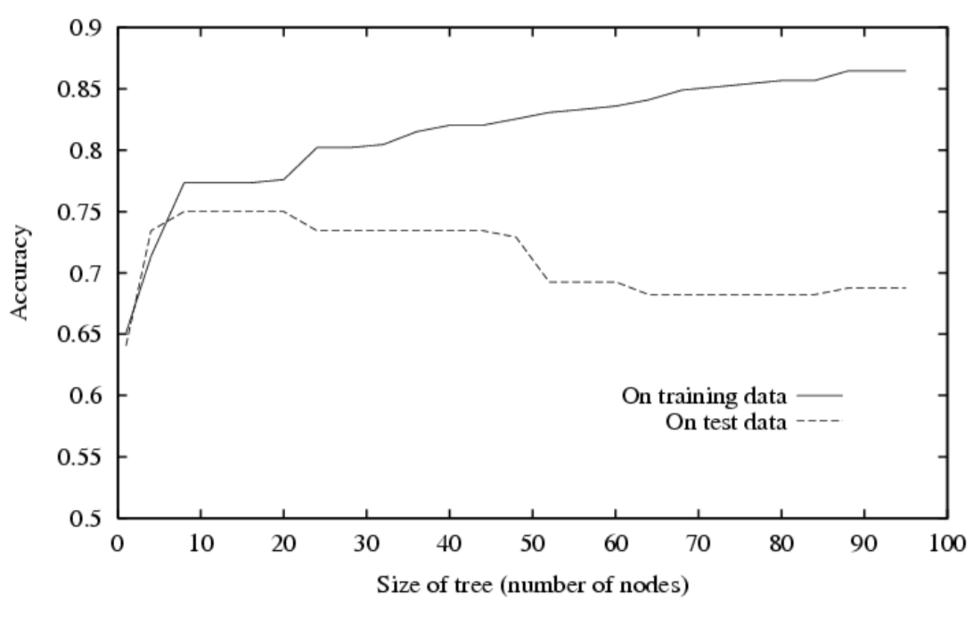
Overfitting of Decision Trees
Overfitting occurs when the learning algorithm continues to develop hypotheses that reduce training set error at the cost of an increased test set error.
Notes:
Trainer Notes: Explain the following:
What is overfitting in decision tree
How does it occurs?
Scenarios where overfitting is most likely to occur
How does it affects the model

Slide 25
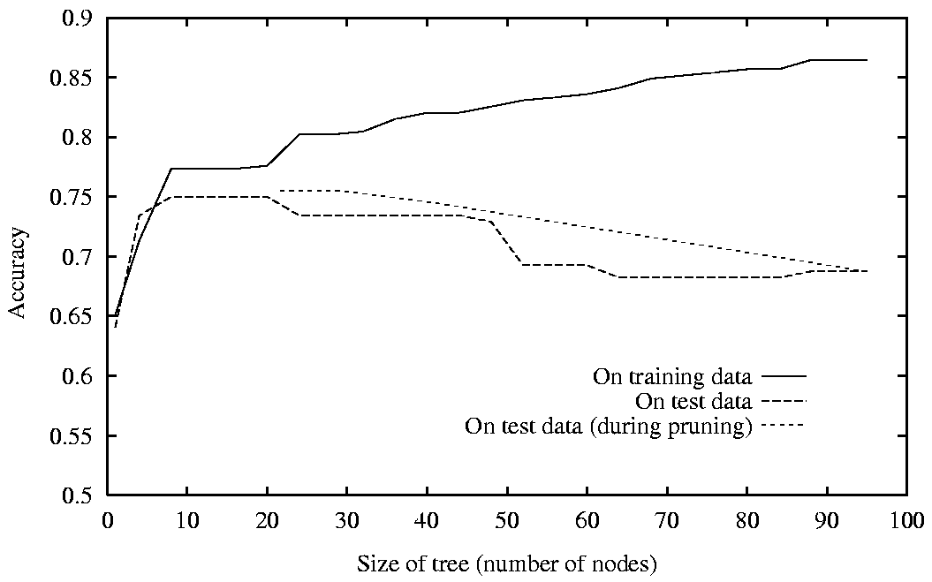
Avoiding Overfitting of Decision Trees
Post Pruning
Notes:
Trainer Notes: Explain the following:
How to avoid overfitting in decision trees.

Slide 26
Classification
Topic 4: Random Forest Classifier
Notes:
Trainer Notes: Explain the following:
What is a random forest classifier
How it helps in classification

Slide 27
Bagging and Bootstrapping
Bagging
Bootstrapping
A technique for reducing the variance of an estimated prediction function
Randomly draws datasets with replacement from the
training data
For classification, a committee of trees each cast a vote for the predicted class
Each sample is of the same size as the original training set
Notes:
Trainer Notes: Explain the following:
Concept of bagging and bootstrapping

Slide 28
Bagging and Bootstrapping
Create bootstrap samples from the training data
M features
N examples
....…
Notes:
Trainer Notes: Explain the following:
Bootstrap samples

Slide 29
Decision Tree Classifier
Each sample contributes to a decision tree classifier
Location
Similarity
M features
Gene
Expression
Domain-motif
N examples
Interact
....…
Neighbor
Function Similarity
Degree
Gene
Expression
Interact
Not Interact
Interact
Not Interact
Interact
Not Interact
Notes:
Trainer Notes: Explain the following:
Each bootstrap sample accounts for individual decision tree

Slide 30
Random Forest Classifier
Location
Similarity
Gene
Expression
Domain-motif
Interact
M features
Neighbor
Function Similarity
Degree
Gene
Expression
Interact
Not Interact
Interact
Not Interact
Interact
Not Interact
N examples
Neighbor
process similarity
Tissue
Expression
Centraility
Take the majority vote
....…
Neighbor
Function Similarity
PTM
Interact
Not Interact
Interact
Not Interact
Interact
Not Interact
Neighbor
process similarity
Tissue
Expression
Centraility
Neighbor
Function Similarity
PTM
Interact
Not Interact
Interact
Not Interact
Interact
Not Interact
Notes:
Trainer Notes: Explain the following:
Combination of individual decision trees leading to random forest classifier
How random forest classifier provides a better accuracy w.r.t decision trees (ideally)

Slide 31
Classification
Topic 5: Performance Measures
Notes:
Trainer Notes: Explain the following:
Significance of measuring model performance

Slide 32
Confusion Matrix
Focus on the predictive capability of a model
 | PREDICTED CLASS
ACTUAL CLASS |  | Class=Yes | Class=No
 | Class=Yes | a | b
 | Class=No | c | d
a: TP (true positive)
b: FN (false negative)
c: FP (false positive)
d: TN (true negative)
Notes:
Trainer Notes: Explain the following:
Concept of confusion matrix
True positives
True negatives
False positives
False negatives

Slide 33
Accuracy Metric
Ratio of true positives and true negatives to the sum of true positives, true negatives, false negatives, and false positives
 | PREDICTED CLASS
ACTUAL CLASS |  | Class=Yes | Class=No
 | Class=Yes | a (TP) | b (FN)
 | Class=No | c (FP) | d (TN)
Notes:
Trainer Notes: Explain the following:
Accuracy prediction based on confusion matrix

Slide 34
Limitation of Accuracy
Consider a 2-class problem
Number of Class 0 examples = 9990
Number of Class 1 examples = 10
If the model predicts every example to be class 0, accuracy is 9990/10000 = 99.9 %
Hence, accuracy is misleading because the model does not detect any class 1 example
Notes:
Trainer Notes: Explain the following:
Why accuracy isn’t always the best parameter to judge model performance

Slide 35
Cost Matrix
Cost matrix takes weights into account
 | PREDICTED CLASS
ACTUAL CLASS | C(i|j) | Class=Yes | Class=No
 | Class=Yes | C(Yes|Yes) | C(No|Yes)
 | Class=No | C(Yes|No) | C(No|No)
Cost of classifying class j example as class i
Notes:
Trainer Notes: Explain the following:
Cost matrix
How weighted accuracy solves the problem associated with normal accuracy matrix

Slide 36
Computing Cost of Classification
Cost Matrix | PREDICTED CLASS
ACTUAL CLASS | C(i|j) | + | -
 | + | -1 | 100
 | - | 1 | 0
Model M₁ | PREDICTED CLASS
ACTUAL CLASS |  | + | -
 | + | 150 | 40
 | - | 60 | 250
Model M₂ | PREDICTED CLASS
ACTUAL CLASS |  | + | -
 | + | 250 | 45
 | - | 5 | 200
Accuracy = 80%
Cost = 3910
Accuracy = 90%
Cost = 4255
Notes:
Trainer Notes: Explain the following:
How these values are obtained

Slide 37
Cost vs. Accuracy
Count | PREDICTED CLASS
ACTUAL CLASS |  | Class=Yes | Class=No
 | Class=Yes | a | b
 | Class=No | c | d
Accuracy is proportional to cost if 1. C(Yes|No)=C(No|Yes) = q 2. C(Yes|Yes)=C(No|No) = p
N = a + b + c + d
Accuracy = (a + d)/N
Cost = p (a + d) + q (b + c)
= p (a + d) + q (N – a – d)
= q N – (q – p)(a + d)
= N [q – (q-p) × Accuracy]
Cost | PREDICTED CLASS
ACTUAL CLASS |  | Class=Yes | Class=No
 | Class=Yes | p | q
 | Class=No | q | p
Notes:
Trainer Notes: Explain the following:
The calculations

Slide 38
Assisted Practice
Random Forest Classifier
Duration: 15 mins.
Problem Statement: Predict the survival of a horse based on various observed medical conditions. Load the data from “horses.csv” and observe whether it contains missing values. The dataset contains many categorical features; replace them with label encoding. Replace the missing values by the most frequent value in each column. Fit a decision tree classifier and random forest classifier, and observe the accuracy.
Objective: Learn to fit a decision tree, and compare its accuracy with random forest classifier.
Access: Click on the Labs tab on the left side panel of the LMS. Copy or note the username and password that are generated. Click on the Launch Lab button. On the page that appears, enter the username and password in the respective fields, and click Login.
Notes:
Trainer Notes:
Explain the above scenario
Download the horse.csv and the corresponding .ipynb file as a reference to demonstrate the above problem
Ask the learners to perform the practice simultaneously on their local system

Slide 39
Unassisted Practice
Random Forest Classifier Duration: 15 mins.
Problem Statement: PeerLoanKart is an NBFC (Non-banking Financial Company) that facilitates peer-to-peer loan.
It connects people who need money (borrowers) with people who have money (investors). As an investor, you would want to invest in people who showed a profile of having a high probability of paying you back.
You “as an ML expert” create a model that will help predict whether a borrower will pay the loan or not.
Objective: Increase profits up to 20% as NPA will be reduced due to loan disbursal for only creditworthy borrowers
Note: This practice is not graded. It is only intended for you to apply the knowledge you gained to solve real-world problems.
Access: Click on the Labs tab on the left side panel of the LMS. Copy or note the username and password that are generated. Click on the Launch Lab button. On the page that appears, enter the username and password in the respective fields, and click Login.
Notes:
Trainer Notes: Explain the following:
The above scenario
Ask the learners to download the loan_borrower_data.csv file to start with the practice

Slide 40
Import Libraries
Code
import pandas as pd
import numpy as np
import matplotlib.pyplot as plt
import seaborn as sns
%matplotlib inline
from sklearn.model_selection import train_test_split

Slide 41
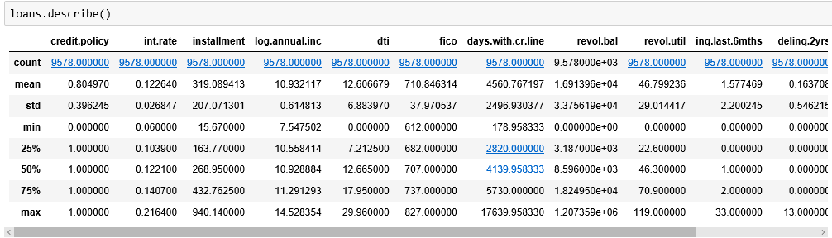
Get the Data
Code
loans = pd.read_csv('loan_borowwer_data.csv’)
loans.describe()

Slide 42
Exploratory Data Analysis
Create a histogram of two FICO distributions on top of each other, one for each credit.policy outcome.
Code
plt.figure(figsize=(10,6))
loans[loans['credit.policy']==1]['fico'].hist(alpha=0.5,color='blue', bins=30,label='Credit.Policy=1')
loans[loans['credit.policy']==0]['fico'].hist(alpha=0.5,color='red', bins=30,label='Credit.Policy=0')
plt.legend()
plt.xlabel('FICO')

Slide 43
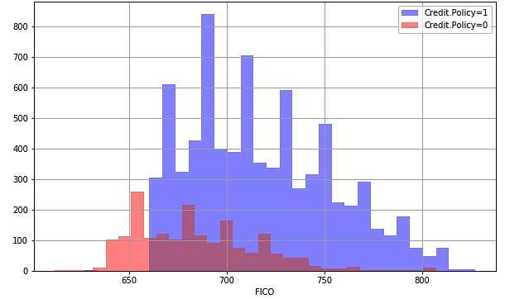
Exploratory Data Analysis

Slide 44
Exploratory Data Analysis
Create a similar figure; select the not.fully.paid column
Code
plt.figure(figsize=(10,6))
loans[loans['not.fully.paid']==1]['fico'].hist(alpha=0.5,color='blue', bins=30,label='not.fully.paid=1')
loans[loans['not.fully.paid']==0]['fico'].hist(alpha=0.5,color='red', bins=30,label='not.fully.paid=0')
plt.legend()
plt.xlabel('FICO')

Slide 45
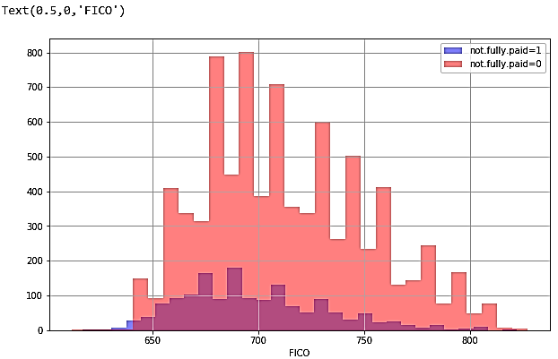
Exploratory Data Analysis

Slide 46
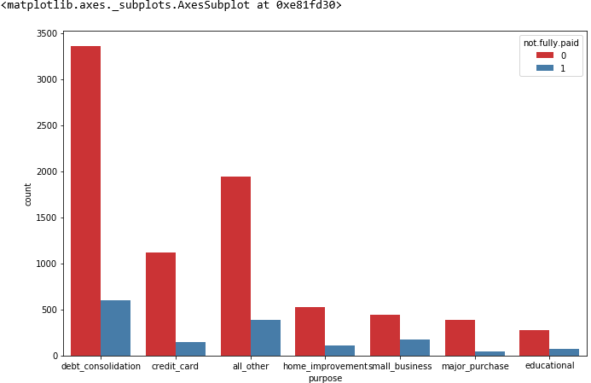
Exploratory Data Analysis
Create a countplot using seaborn showing the counts of loans by purpose, with the hue defined by not.fully.paid.
Code
plt.figure(figsize=(11,7))
sns.countplot(x='purpose',hue='not.fully.paid',data=loans,palette='Set1')

Slide 47
Setting Up the Data
Create a list of elements, containing the string “purpose.” Call this list cat_feats.
Code
cat_feats = ['purpose’]

Slide 48
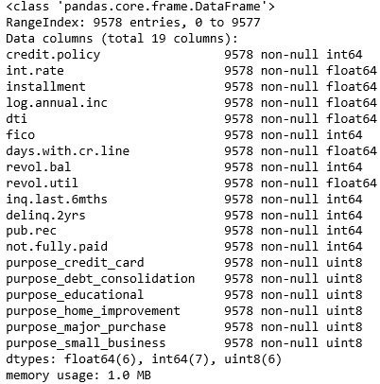
Setting Up the Data
Now use pd.get_dummies (loans,columns=cat_feats,drop_first=True) to create a fixed larger data frame that has new feature columns with dummy variables. Set this data frame as final_data.
Code
final_data = pd.get_dummies(loans,columns=cat_feats,drop_first=True)
final_data.info()

Slide 49
Train-Test Split
Code
X = final_data.drop('not.fully.paid',axis=1)
y = final_data['not.fully.paid']
X_train, X_test, y_train, y_test = train_test_split(X, y, test_size=0.30, random_state=101)

Slide 50
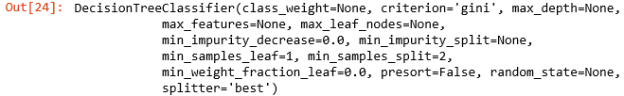
Training Decision Tree Model
Code
from sklearn.tree import DecisionTreeClassifier
dtree = DecisionTreeClassifier()
dtree.fit(X_train,y_train)

Slide 51
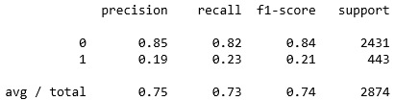
Evaluating Decision Tree
Create predictions from the test set, and create a classification report and a confusion matrix.
Code
predictions = dtree.predict(X_test)
from sklearn.metrics import classification_report,confusion_matrix
print(classification_report(y_test,predictions))
Notes:
Trainer Notes:
Explain precision, recall, f1-score, support.

Slide 52

Confusion Matrix
Code
print(confusion_matrix(y_test,predictions))

Slide 53
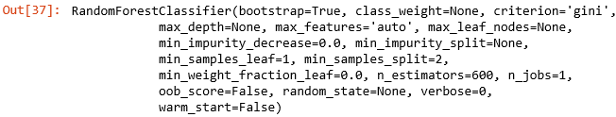
Training Random Forest Model
Code
from sklearn.ensemble import RandomForestClassifier
rfc = RandomForestClassifier(n_estimators=600)
rfc.fit(X_train,y_train)

Slide 54
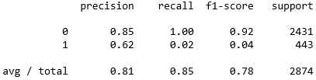
Evaluating Random Forest Model
Code
predictions = rfc.predict(X_test)
from sklearn.metrics import classification_report,confusion_matrix
print(classification_report(y_test,predictions))

Slide 55

Printing the Confusion Matrix
Code
print(confusion_matrix(y_test,predictions))

Slide 56
Classification
Topic 7: Naïve Baye’s Classifier
Notes:
Trainer Notes: Explain the following:
How it is a classification algorithm

Slide 57

Naïve Baye’s Classifier and Baye’s Theorem
Classification technique based on Baye’s theorem
Example:
Baye’s Theorem
P(A|B) = P(B|A) P(A)
P(B)
P(A) – Class Prior Probability
P(B|A) – Likelihood
P(A|B) – Posterior Probability
P(A) - Predictor Prior Probability
Where,
Note: Naive Baye’s classifier assumes that the presence of a particular feature in a class is unrelated to the presence of any other feature.
Notes:
Trainer Notes: Explain the following:
Naiive Bayes classifier is based on baye’s theorem

Slide 58
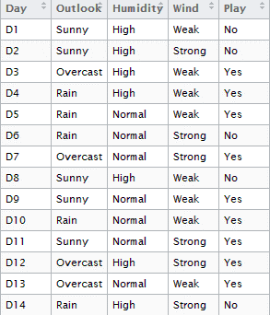
Naïve Baye’s Classifier: Example
As the first step toward prediction using naïve bayes, you will have to estimate frequency of each and every attribute
Frequency Table
Play
Yes
No
Outlook
Sunny
3
2
Overcast
4
0
Rainy
3
2
Frequency Table
Play
Yes
No
Humidity
High
3
4
Normal
6
1
Frequency Table
Play
Yes
No
Wind
Strong
6
2
Weak
3
3
Notes:
Trainer Notes: Explain the following:
The above example which predicts whether a game will be played or not based on the above climatic conditions

Slide 59
Building Likelihood Tables
Calculating likelihood of each attribute
Likelihood Table
Play
P(B|A) = P(Sunny|Yes) = 3/9 = 0.33
Yes
No
Outlook
Sunny
3/9
2/5
5/14
P(B) = P(Sunny) = 5/14 = 0.36
Overcast
4/9
0/5
4/14
Rainy
3/9
2/5
5/14
P(A) = P(Yes) = 10/14 = 0.71
10/14
4/14
Similarly likelihood of “No” given Sunny is:
P(A|B) = P(No|Sunny) = P(Sunny|No)* P(No) / P(Sunny) = (0.4 x 0.36) /0.36 = 0.40
Notes:
Trainer Notes: Explain the following:
Building likelihood tables

Slide 60
Building Likelihood Tables
Likelihood table for Humidity
Likelihood table for Wind
Likelihood Table
Play
Likelihood Table
Play
Yes
No
Yes
No
Humidity
High
3/9
4/5
7/14
Wind
Weak
6/9
2/5
8/14
Normal
6/9
1/5
7/14
Strong
3/9
3/5
6/14
9/14
5/14
9/14
5/14
P(Yes|High) = 0.33 x 0.6 / 0.5 = 0.42
P(Yes|Weak) = 0.67 x 0.64 / 0.57 = 0.75
P(No|High) = 0.8 x 0.36 / 0.5 = 0.58
P(No|Weak) = 0.4 x 0.36 / 0.57 = 0.25
Notes:
Trainer Notes: Explain the following:
Calculations for each of the features

Slide 61
Getting the Output
Outlook = Rain
Humidity = High
Wind = Weak
Play = ?
Likelihood of “Yes” = P(Outlook = Rain|Yes)*P(Humidity= High|Yes)* P(Wind= Weak|Yes)*P(Yes) = 2/9 * 3/9 * 6/9 * 9/14 = 0.0199
Likelihood of “No” = P(Outlook = Rain|No)*P(Humidity= High|No)* P(Wind= Weak|No)*P(No) = 2/5 * 4/5 * 2/5 * 5/14 = 0.0166
Notes:
Trainer Notes: Explain the following:
Calculating the likelihood of yes (Overall)
Calculating the likelihood of no (Overall)

Slide 62
Getting the Output
Normalizing the values
P(Yes) = 0.0199 / (0.0199+ 0.0166) = 0.55
P(No) = 0.0166 / (0.0199+ 0.0166) = 0.45
The model predicts that there is a 55% chance
that there will be game tomorrow
Notes:
Trainer Notes: Explain the following:
What is the significance of normalizing values
Calculating normalizes values

Slide 63
Classification
Topic 8: Support Vector Machines
Notes:
Trainer Notes: Explain the following:
How support vector machines are a classification algorithm

Slide 64




Linear Separators
Consider a binary separation which can be viewed as the task of separating classes in feature space.
$$w^{T}x+b=0$$
$$w^{T}x+b>0$$
$$w^{T}x+b<0$$
$$f\left(x\right)=sign(w^{T}x+b)$$
Notes:
Trainer Notes: Explain the following:
Concept of linear separators with respect to the above equation

Slide 65
Optimal Separation
It’s difficult to evaluate the optimal separator.
Notes:
Trainer Notes: Explain the following:
Concept of optimal separators
Why it is difficult to evaluate optimal separators

Slide 66


Concept of Classification Margin
$$ρ$$
$$r$$
Distance from example x_{i} to the separator is
Closest to the hyperplane are support vectors.
Margin ρ of the separator is the distance between support vectors.
Notes:
Trainer Notes: Explain the following:
What is classification margin
What is hyperplane
How is the distance calculated

Slide 67
Maximizing Classification Margin
Helps generalize the predictions and perform better on the test data by not overfitting the model to the training data
Takes care only of the support vectors, ignoring other training examples
Notes:
Trainer Notes: Explain the following:
Why are we supposed to maximize classification margin
How it avoids overfitting

Slide 68
Linear SVM: Mathematically
Let training set {(x_{i}, y_{i})}_{i=1..n}, x_{i}∈R^{d}, y_{i} ∈ {-1, 1} be separated by a hyperplane with margin ρ. Then for each training example (x_{i}, y_{i}):
w^{T}x_{i} + b ≤ - ρ/2 if y_{i} = -1
w^{T}x_{i} + b ≥ ρ/2 if y_{i} = 1
⇔
y_{i}(w^{T}x_{i} + b) ≥ ρ/2
For every support vector x_{s}, the above inequality is an equality. After rescaling w and b by ρ/2 in the equality, you obtain the distance between each x_{s.} The hyperplane is:
Then the margin can be expressed through (rescaled) w and b as:
Notes:
Trainer Notes: Explain the following:
The above mathematical calculations

Slide 69
Linear SVM: Mathematically
Now, you can formulate the quadratic optimization problem:
Find w and b such that is maximized
and for all (x_{i}, y_{i}), i=1..n : y_{i}(w^{T}x_{i} + b) ≥ 1
You can reformulate the problem as:
Find w and b such that
Φ(w) = ||w||²=w^{T}w is minimized
and for all (x_{i}, y_{i}), i=1..n : y_{i} (w^{T}x_{i} + b) ≥ 1
Notes:
Trainer Notes: Explain the following:
The above mathematical calculations

Slide 70
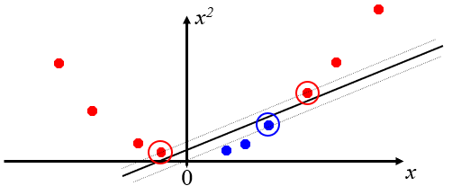
Nonlinear SVMs
Scenario 1
Datasets that are linearly separable with some noise:
0
x
Scenario 2
When the dataset is hard:
0
x
Scenario 3
Mapping data to a higher dimensional space
Notes:
Trainer Notes: Explain the following:
Non linear SVM’s
Scenarios giving rise to non linear data

Slide 71

Nonlinear SVMs: Feature Spaces
The original feature space can always be mapped to some higher-dimensional feature space where the training set is separable.
$$φ: x→φ(x)$$
Notes:
Trainer Notes: Explain the following:
Compare feature space with non linear SVM
Why mapping data to a feature space is more convenient

Slide 72
The Kernel Trick
The linear classifier relies on inner product between vectors K(x_{i},x_{j})=x_{i}^{T}x_{j}
If every datapoint is mapped into high-dimensional space via some transformation Φ: x → φ(x), the inner product becomes:
K(x_{i},x_{j})= φ(x_{i}) ^{T}φ(x_{j})
A kernel function is a function that is equivalent to an inner product in a feature space.
Example:
2-dimensional vectors x=[x₁ x₂]; let K(x_{i},x_{j})=(1 + x_{i}^{T}x_{j})²,
Need to show that K(x_{i},x_{j})= φ(x_{i}) ^{T}φ(x_{j}):
K(x_{i},x_{j})=(1 + x_{i}^{T}x_{j})²,= 1+ x_{i1}²x_{j1}² + 2 x_{i1}x_{j1} x_{i2}x_{j2}+ x_{i2}²x_{j2}² + 2x_{i1}x_{j1} + 2x_{i2}x_{j2}=
= [1 x_{i1}² √2 x_{i1}x_{i2} x_{i2}² √2x_{i1} √2x_{i2}]^{T} [1 x_{j1}² √2 x_{j1}x_{j2} x_{j2}² √2x_{j1} √2x_{j2}] =
= φ(x_{i}) ^{T}φ(x_{j}), where φ(x) = [1 x₁² √2 x₁x₂ x₂² √2x₁ √2x₂]
Thus, a kernel function implicitly maps data to a high-dimensional space (without the need to compute each φ(x) explicitly).
Notes:
Trainer Notes: Explain the following:
The kernel function and its significance
How a kernel function maps data to feature space with respect to the above calculations

Slide 73
Assisted Practice
Support Vector Machines
Duration: 15 mins.
Problem Statement: Motion Studios is the largest radio production house in Europe. Its total revenue is $ 1B+. The company has launched a new reality show "The Star RJ." The show is about finding a new radio jockey who will be the star presenter on upcoming shows.
In the first round, participants have to upload their voice clip online. The clip will be evaluated by experts for selection to the next round. There is a separate team in the first round for evaluation of male and female voice.
Response to the show is unprecedented, and company is flooded with voice clips.
You “as an ML” expert have to classify the voice as either male or female so that the first level of filtration is quicker.
Objective: Optimize selection process.
Access: Click on the Labs tab on the left side panel of the LMS. Copy or note the username and password that are generated. Click on the Launch Lab button. On the page that appears, enter the username and password in the respective fields, and click Login.
Notes:
Trainer Notes:
Explain the above problem scenario
Download the voice classification.csv from the LMS and perform the modeling in python
Download the corresponding .ipynb file for further reference

Slide 74
Unassisted Practice
Support Vector Machines Duration: 15 mins.
Problem Statement: Load the data from “college.csv” that has attributes collected about private and public colleges for a particular year. Predict the private/public status of the colleges from other attributes.
Use LabelEncoder to encode the target variable to numerical form. Split the data such that 20% of the data is set aside for testing. Fit a linear svm from scikit learn and observe the accuracy. [Hint: Use Linear SVC]
Preprocess the data using StandardScalar and fit the same model again. Observe the change in accuracy.
Use scikit learn’s gridsearch to select the best hyperparameter for a nonlinear SVM. Identify the model with best score and its parameters. [Hint: Refer to model_selection module of Scikit learn]
Objective: Employ SVM from scikit learn for binary classification and measure the impact of preprocessing data and hyper parameter search using grid search.
Note: This practice is not graded. It is only intended for you to apply the knowledge you have gained to solve real-world problems.
Access: Click on the Labs tab on the left side panel of the LMS. Copy or note the username and password that are generated. Click on the Launch Lab button. On the page that appears, enter the username and password in the respective fields, and click Login.
Notes:
Trainer Notes: Explain the following:
The above scenario
Ask the learners to load college.csv file to proceed with the practice

Slide 75

Import the Dataset
Code
import pandas as pd
df = pd.read_csv("College.csv")
df.columns

Slide 76
Label Encoding
Code
from sklearn.model_selection import train_test_split
from sklearn.preprocessing import LabelEncoder
X, y = df.iloc[:, 1:].values, df.iloc[:, 0].values
# male -> 1
# female -> 0
target_encoder = LabelEncoder()
y = target_encoder.fit_transform(y)
X_train, X_test, y_train, y_test = train_test_split(X, y, test_size=0.2, random_state=1)
print(X_train.shape)

Slide 77

Fit the Linear SVC Classifier
Code
from sklearn.svm import LinearSVC,SVC
classifier = LinearSVC()
classifier.fit(X_train,y_train)
y_predict = classifier.predict(X_test)
classifier.score(X_test,y_test)

Slide 78

Obtain Performance Matrix
Code
from sklearn.metrics import confusion_matrix
print(confusion_matrix(y_predict,y_test))

Slide 79
Fit the SVC Classifier
Code
classifier = SVC()
classifier.fit(X_train,y_train)
classifier.score(X_test,y_test)

Slide 80
Preprocess the Data
Code
from sklearn.model_selection import GridSearchCV
from sklearn.preprocessing import StandardScaler
scaler = StandardScaler()
X, y = df.iloc[:, 1:].values, df.iloc[:, 0].values
X = scaler.fit_transform(X)
target_encoder = LabelEncoder()
y = target_encoder.fit_transform(y)
X_train, X_test, y_train, y_test = train_test_split(X, y, test_size=0.2, random_state=1)
print(X_train.shape)

Slide 81
Refitting the SVC Model
Code
classifier = SVC()
classifier.fit(X_train,y_train)
classifier.score(X_test,y_test)

Slide 82
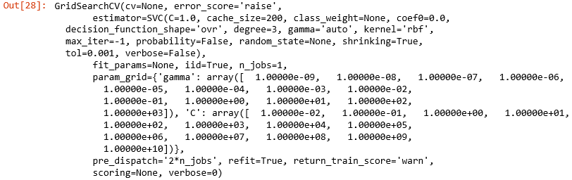
Fitting Grid Search
Code
import numpy as np
from sklearn.model_selection import StratifiedShuffleSplit
C_range = np.logspace(-2, 10, 13)
gamma_range = np.logspace(-9, 3, 13)
param_grid = dict( gamma=gamma_range,C=C_range)
grid = GridSearchCV(SVC(), param_grid=param_grid)
grid.fit(X_train, y_train)
Notes:
Trainer Notes:
Explain why we are using Grid SearchCV here.

Slide 83
Getting the Best Hyperparameter
Code
print("The best parameters are %s with a score of %0.2f"
% (grid.best_params_, grid.best_score_))

Slide 84
Now, you are now able to:
Understand classification as part of supervised learning
Demonstrate different classification techniques in Python
Evaluate classification models

Slide 85

© Simplilearn. All rights reserved.

Slide 86
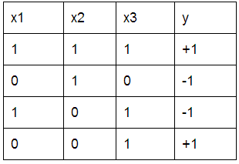
Let us train T1, a decision tree, with the data given below. Which feature will you split at the root?
1
x1
x2
x3
y
© Simplilearn. All rights reserved.

Slide 87
Let us train T1, a decision tree, with the data given below. Which feature will you split at the root?
1
x1
x2
x3
y
c. x3
x3 will split because it has the lowest classification error. At row 3, x3=1, y=-1; there is only one error compared to other features.

Slide 88
If you are training a decision tree, and you are at a node in which all of its data has the same y value, you should:
2
Find the best feature to split
Create a leaf that predicts the y value of all the data
Terminate recursions on all branches and return the current tree
Go back to the parent node and select a different feature to split so that the y values are not all the same at this node
© Simplilearn. All rights reserved.

Slide 89
If you are training a decision tree, and you are at a node in which all of its data has the same y value, you should
2
Find the best feature to split
Create a leaf that predicts the y value of all the data
Terminate recursions on all branches and return the current tree
Go back to the parent node and select a different feature to split so that the y values are not all the same at this node
b. Create a leaf that predicts the y value of all the data
You should create a leaf that predicts the y value of all the data.

Slide 90
Lesson-End Project
Duration: 20 mins.
Problem Statement: Load the kinematics dataset as measured on mobile sensors from the file “run_or_walk.csv.” List the columns in the dataset. Let the target variable “y” be the activity, and assign all the columns after it to “x.”
Using Scikit-learn, fit a Gaussian Naive Bayes model and observe the accuracy. Generate a classification report using Scikit-learn. Repeat the model once using only the acceleration values as predictors and then using only the gyro values as predictors. Comment on the difference in accuracy between both the models.
Objective: Practice classification based on Naive Bayes algorithm. Identify the predictors that can be influential.
Access: Click the Labs tab in the left side panel of the LMS. Copy or note the username and password that are generated. Click the Launch Lab button. On the page that appears, enter the username and password in the respective fields, and click Login.
Notes:
Trainer Notes: Explain the project to the learners and instruct them to perform it after the lesson.

Slide 91
© Simplilearn. All rights reserved.

